Slide 1

Rich Internet Application DevelopmentDesign
HTML5
(Canvas & SVG)
Notes:
Please open up this week demo folder at \HTML5_Canvas_SVG_Demo_Files using Visual studio 2010 .

Slide 2
WHAT IS A CANVAS?
The <canvas> element is used to draw graphics on a webpage via scripting (JavaScript)
The <canvas> element is only a container for the graphics. You must use script to draw the graphics.
Internet explorer 9, Firefox, Opera, Chrome, and Safari support <canvas>. Internet
Note: Internet Explorer 8 and earlier versions, do not support the <canvas> element.

Slide 3
HOW TO CREATE A CANVAS?
  A canvas is a rectangular area on a HTML page. By default the canvas will not be visible.
  To make the canvas visible, add the borders like this :
  You can also add colours to the canvas. The fillRect(x,y,width,height) method draws a rectangle filled with the current fill style. FillStyle property can be a CSS color, a gradient, or a pattern.
<canvas id="myCanvas" width="200" height="100"></canvas>
<script type="text/javascript">
var c=document.getElementById("myCanvas");
var ctx=c.getContext("2d");
ctx.fillStyle="#FF0000";
ctx.fillRect(0,0,150,75);
</script>

Slide 4
HOW TO CREATE A CANVAS?
  Step 1 - Create a <canvas> tag in your first
  Step 2 - find the <canvas> element:
  Step 3 - Call its getContext() method (you must pass the string "2d" to the getContext() method
  Step 4 - The getContext("2d") object is a built-in HTML5 object, with many properties and methods for drawing paths, boxes, circles, text, images, and more.
  Step 5 – Do your drawing, Eg. The next two lines draws a red rectangle:
var c=document.getElementById("myCanvas");
var ctx=c.getContext("2d");
ctx.fillStyle="#FF0000";
ctx.fillRect(0,0,150,75);

Slide 5
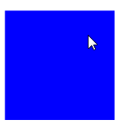
Creating CANVAS with onload
<head>
<meta http-equiv="X-UA-Compatible" content="IE=9"/>
<style type="text/css" media="screen">
</style>
<script type="text/javascript">
function init() {
var canvas = document.getElementById("myCanvas");
var ctx = canvas.getContext("2d");
ctx.fillStyle = "rgb(0,0,255)";
ctx.fillRect(10, 10, 100, 100);
}
</script>
</head>
<body onload="init();">
<canvas id="myCanvas" width="100px" height="100px"></canvas>
</body>
Notes:
Demo : 005 - Canvas Basic - bluerect.htm
Declare your<canvas> element in your html5 markup, give it an ID
Get the context of the canvas, the ID and the 2d context.
After that you can use javascript library/API to draw the rectangle in the library.
Then you can define once the document loads, you want to call the init() function, which will draw the rectangle on your canvas.
In init(), it will receive your myCanvas DOM element, and get the 3d context, then after that draw the rectangle and fill with color.

Slide 6
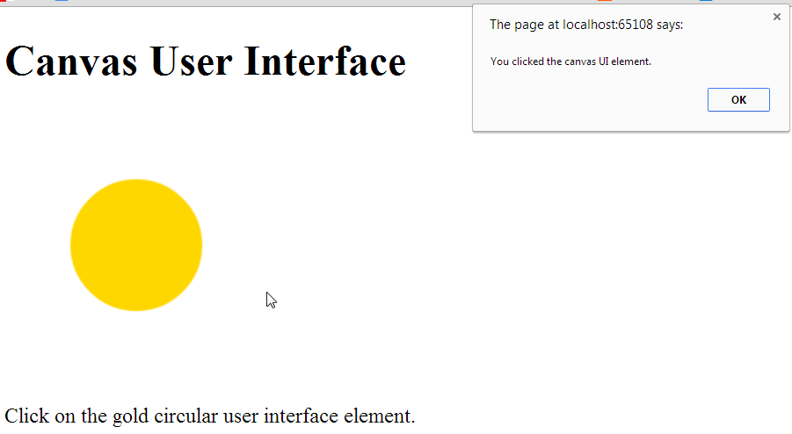
Creating CANVAS with onload
Notes:
DEMO: 006 - Canvas Basic - OnClick.htm
SVG will let u know every element you draw so its easy to identify where you have clicked.
CANVAS IS LIKe a blackbox, you need to use javascript to detect your mouse position.
So in this example, even if you click outside the yellow circle, the pop up will appear.

Slide 7
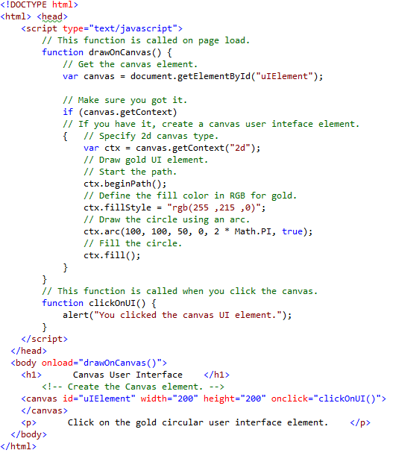
Canvas with Event handler
Notes:
DEMO: 006 - Canvas Basic - OnClick.htm
Codings for Canvas with event handler.

Slide 8
Canvas DEMO with drawing, images, videos, animation
https://davidwalsh.name/canvas-demos

Slide 9
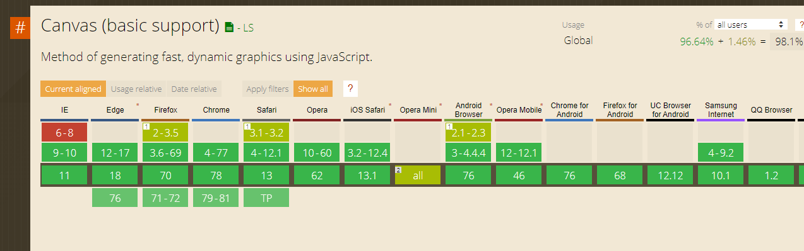
Canvas Support
For other browsers support and versions : http://caniuse.com/canvas
Notes:
Filter effects are supported / can be achieved by CSS3.
Most SVG features are supported by the latest versions of major browsers

Slide 10


Canvas Characteristics Overview
Allow drawing into a bitmap area
  See it as a dynamic PNG ;-)
Uses JavaScript APIs & drawing primitives
  Rectangles, lines, fills, arcs, Bezier curves, etc. similar to SVG
Immediate mode : « Fire and Forget »
  It’s up to you to maintain your objects tree
Canvas is a black box : content not visible into the DOM
  Beware of accessibility issues

Slide 11
SVG DEMO
http://snapsvg.io/demos

Slide 12
SVG
HTML5 has support for inline SVG
What is SVG?
SVG stands for Scalable Vector Graphics
SVG is used to define vector-based graphics for the Web
SVG defines the graphics in XML format
SVG graphics do NOT lose any quality if they are zoomed or resized
Every element and every attribute in SVG files can be animated
SVG is a W3C recommendation

Slide 13
SVG Basics – Scalable Vector Graphic
To draw 2D vector graphics using XML
“retained mode” : the objects tree is kept in memory
Access to the SVG elements through the DOM
SVG elements can be styled with CSS & can be decorated with ARIA
Can be used from an external .svg file or in-line in the document
Notes:
As it is kept in memory, the SVG elements can be accessed via DOM. This gives
Also you can style SVG elements using CSS
Aria tool is good for accessibility in SVG
Can be stored as XML definition inside SVG file, so you can use/reference it in your HTML document

Slide 14
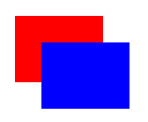
HTML 5 <SVG>Example
<svg width="400" height="200" xmlns="http://www.w3.org/2000/svg">
<rect fill="red" x="20" y="20" width="100" height="75" />
<rect fill="blue" x="50" y="50" width="100" height="75" />
</svg>
Notes:
Using rectangle primitive (RECT) . To define the size (px) and fill type to draw it on html.
Place this inside the <body> </body> tag

Slide 15
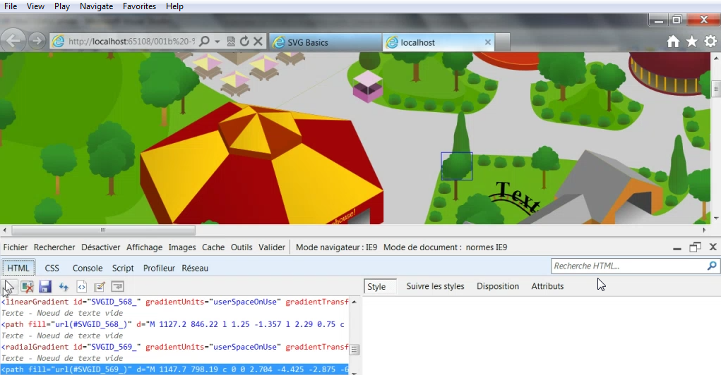
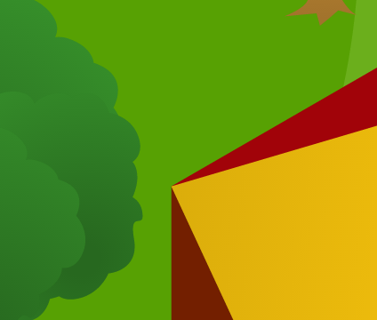
Notes:
Demo: 001b - SVG Basics - RichScene.htm
For more complex scenes, notice that every SVG path/object path can be targetted.
Every graphic can be targetted.
Every element of the SVG tree, is alive in the DOM, so you can manipulate every element through usage of CSS, Javascript or APIs.
Also you can include text in SVG.
Do a Ctrl-F you can find the text “Text”.
These text are searchable via web crawlers such as Google search. So SEO can be incorporated into the SVG page.
Lastly,If you zoom in, quality is not lost as its vector based

Slide 16
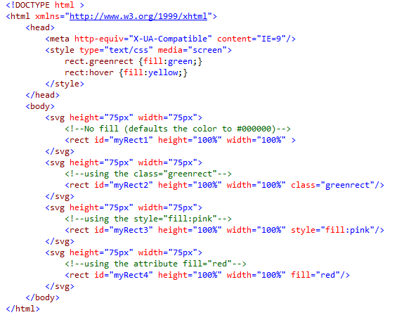
CSS Styling with SVG
Notes:
Demo : 002 - SVG Basics - svgstyling.htm
See code first:
Example of 4 different rectangles
1st one use default color
<rect id="myRect1" height="100%" width="100%" >
2nd one use CSS class “greenrect” so it uses fill color specified in the css file
<rect id="myRect2" height="100%" width="100%" class="greenrect"/>
3rd one use implicit style specified in the marker tag “pink”
<rect id="myRect3" height="100%" width="100%" style="fill:pink"/>
4th one uses fill property.
<rect id="myRect4" height="100%" width="100%" fill="red"/>
Looking at css on top:
<style type="text/css" media="screen">
rect.greenrect {fill:green;}
rect:hover {fill:yellow;}
</style>
Class Greenrect fills green color
Hovering the rectangle, fill yellow color

Slide 17
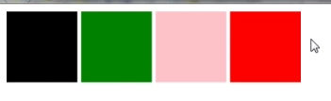

CSS Styling with SVG
On mouse out – based on predefined styling
On mouse over
Notes:
Demo : 002 - SVG Basics - svgstyling.htm

Slide 18
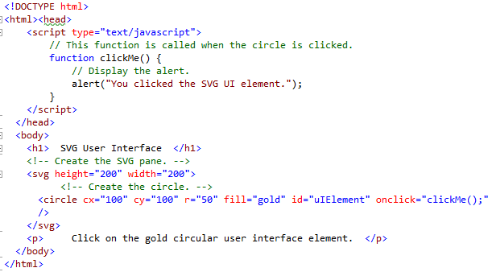
Handling click event with SVG
Notes:
Primitive Circle is drawn in the svg here.
IS is named the DOM id uIElement and assigned the onclick event handler.
So upon clicking inside circle, messagebox is displayed.
Click outside circle – no events raised.
Click in circle – event is raised.

Slide 19
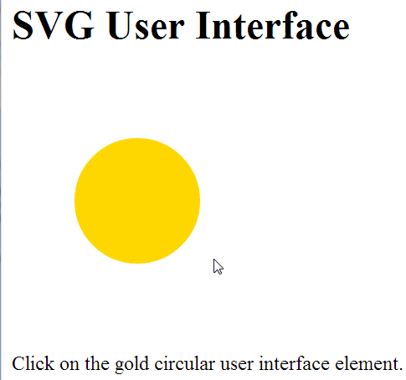
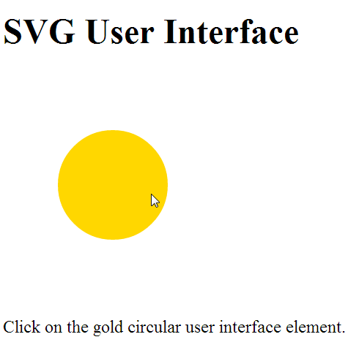
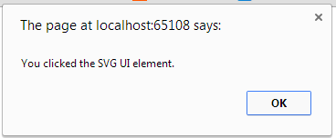
Handling click event with SVG
Notes:
Primitive Circle is drawn in the svg here.
IS is named the DOM id uIElement and assigned the onclick event handler.
So upon clicking inside circle, messagebox is displayed.
Click outside circle – no events raised.
Click in circle – event is raised.

Slide 20
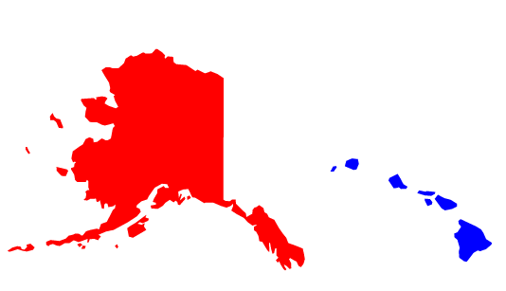
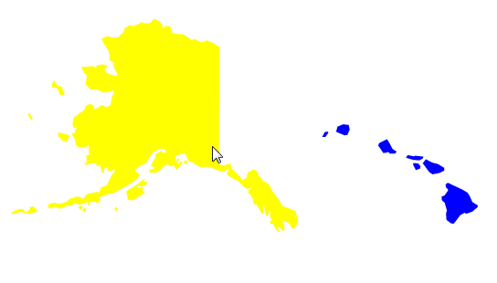
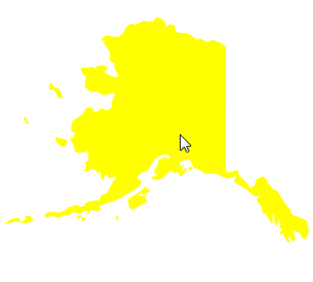
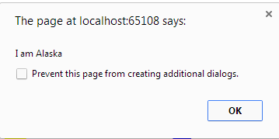
Combining events & styling
Before mouse over After mouse over
On clicking the Alaska map, pop up appears
Notes:
Demo : 004 - SVG Basics - svginteractivity.htm
Eg. Combing the events and styling,
For eg you need to know which.

Slide 21
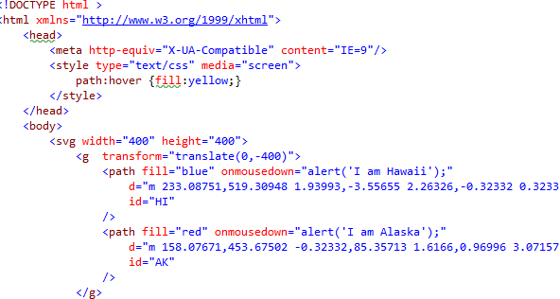
Combining events & styling
Notes:
Demo (Coding) : 004
SVG Basics - svginteractivity.htm
The maps drawn on <Svg>, which contains several areas of complex paths <path> which can be generated by tools shown later.
d="m 233.08751,519.30948 1.93993,-3.55655 2.26326,-0.32332 ….
d="m 158.07671,453.67502 -0.32332,85.35713 1.6166,0.96996 3.071…..
Then register each <path> area with some event handler, which will creates the popup alert
<path fill="blue" onmousedown="alert('I am Hawaii');"
<path fill="red" onmousedown="alert('I am Alaska');"
and the CSS hover property will help create the mouseover effect. (Change to yellow)
<style type="text/css" media="screen">
path:hover {fill:yellow;}
</style>

Slide 22
SVG - Advantages
Advantages of using SVG over other image formats (like JPEG and GIF) are:
SVG images can be created and edited with any text editor
SVG images can be searched, indexed, scripted, and compressed
SVG images are scalable
SVG images can be printed with high quality at any resolution
SVG images are zoomable (and the image can be zoomed without degradation)

Slide 23
Key SVG Scenarios
High Fidelity Complex Vector Document
Graphs / Charts / Maps
  Removes load from server to produce high fidelity graphics
  Supports end user interactivity and Ajax style data updates
    Currently used on Google and Bing
Media and Graphics
  CSS or background images
  Posters (great for printing)
  JavaScript-animated Graphics
Notes:
Using vector, good for complex diagrams need to be zoomed in.
Keep rendering at client side, Good for graphs and charts, maps,
Eg. Rather than reading images from server side.
Supports user interactivity such as charts with values, etc.
Media and Graphics – smaller size using vector based drawing. Can apply CSS and interactivity to graphics with javascript

Slide 24
Key SVG Scenarios
Gaming
Better SEO & Accessibility (can be coupled with ARIA)
Notes:
Gaming usually better with Canvas, but some scenerios SVG works too.
Better for Search Engine Optimization are text can be embedded through SVG.

Slide 25
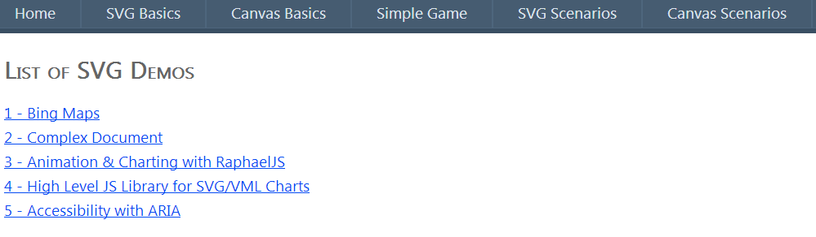
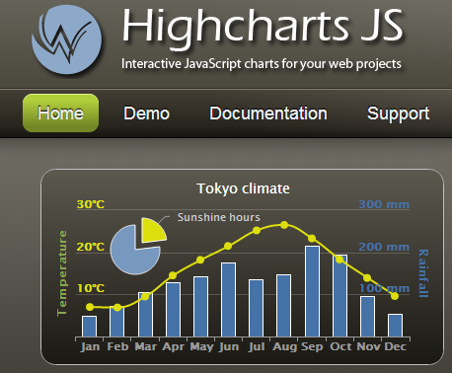
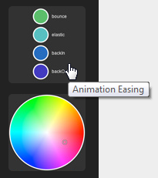
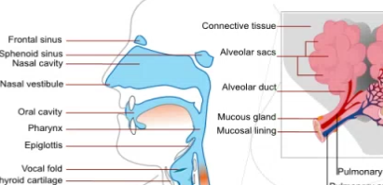
SVG Scenarios & Demo
Notes:
Demo: KeySVGScenarios.aspx
1. Bing Map - MAP and overlay. Zoom in, no loss of quality
2. Complex Document – Zoom in for no loss of quality
3. Animation and Charting with RaphaelJS (http://raphaeljs.com/)
Helps u use high level primitives (And other classes from libraries) to create interactive elements or drawing easily on SVG. Charting is also supported
4. High Level JS Library – HighChart.
Just need to specify the different data you want to provide to the library, and to call a full line of different functions to achieve very interactive output in real time
Backward compatibility using VML (Old version of Vector graphics). So supported by older browsers.

Slide 26
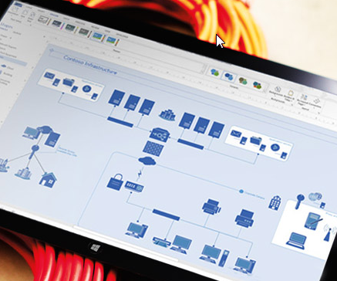



Tools to generate SVG
You won’t be forced to type XML in notepad!
Microsoft Visio
  Export as SVG
Adobe Illustrator
  Save as SVG
Inkspace
  Free Open source software
Notes:
Draw your vector graphics shape in viso or illustrator with plug ins , and export/ save it as SVG

Slide 27
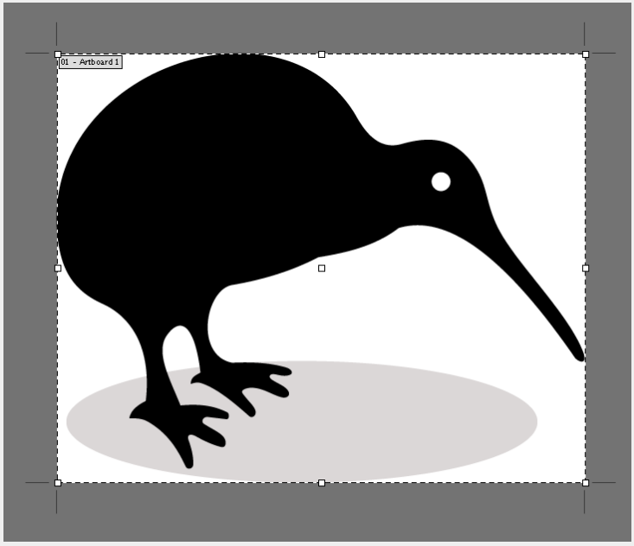
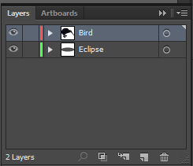
Using Adobe illustrator to generate SVG paths
For eg. You can design something in Adobe llustrator. Here's a Kiwi bird standing on an oval.
The layer name will become the id for the respective path in SVG. In this case, we name them Bird and Eclipse.
Notes:
Save the file as SVG format.

Slide 28
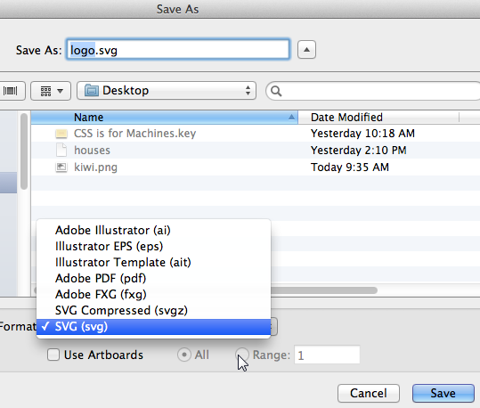
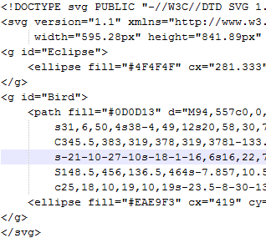
Using Adobe illustrator to generate SVG paths
Save the file as SVG Format
After you have saved the file, you can reopen the file using any text editor, and find the code representing the SVG vector image. Note the ids Bird and Eclipse generated.
Notes:
Save the file as SVG format.

Slide 29
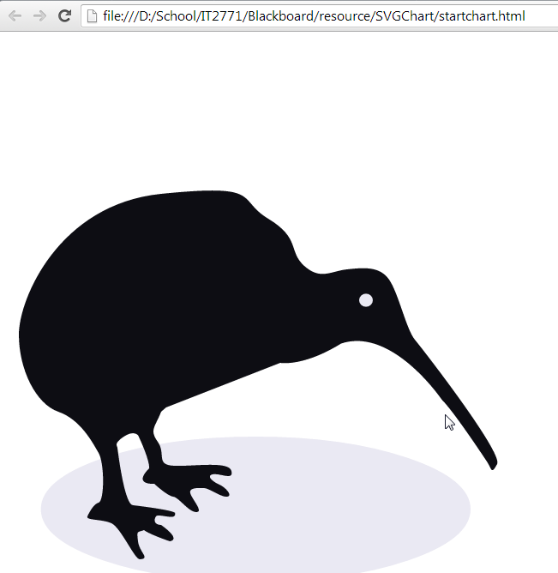
Using Adobe illustrator – Styling & Interactivity with CSS3
Including the svg in your HTML document gives you:
We can jump into the code and give them class names, and then style it in your CSS document. Here, we can add interactivity and CSS to it.
.
<svg ...> <g id="Bird" > <path class="kiwi" .../> </g> <g id="Eclipse"> <ellipse class="ground" .../> </g> </svg>

Slide 30
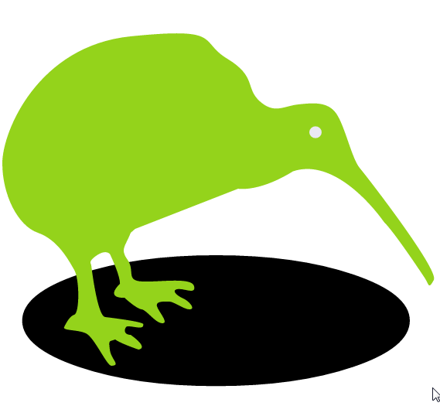
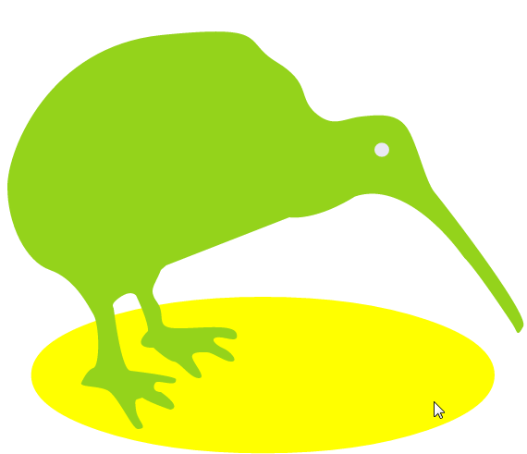
Using Adobe illustrator - Styling & Interactivity with CSS3
Then include the interactive hover property in CSS definition, to achieve the desired interactivity:
.
<style> .kiwi { fill: #94d31b; } .kiwi:hover { fill: #ace63c;} .ground { fill: #FFFFF;} .ground:hover { fill: yellow;} </style>

Slide 31
Adding Event Listeners to with Javascript DOM
In DOM using Javascript,
The addEventListener method of the document object is used to add event listeners to it that apply to corresponding handler functions.
Parameters
event
A string representing the DOM event you wish to target.
function
The function that stands ready to run when the event fires off.
useCapture
An optional boolean value that specifies whether or not you want all events of this type to be associated with the specified listener function before reaching other listeners beneath it in the document for that type of event. Default value is false if not specified.
document.addEventListener( event, function, useCapture )

Slide 32
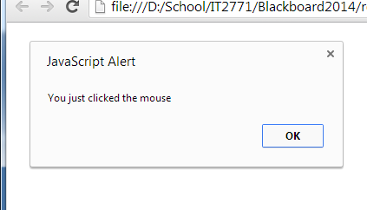
Adding Event Listeners (Javascript) – Example 1
In DOM using Javascript,
<!DOCTYPE html>
<html>
<head>
<script type="text/javascript">
function init(){
document.addEventListener("click", myFunction, false);
function myFunction(){
alert("You just clicked the mouse");
}
}
window.onload = init;
</script>
</head>
<body>
</body>
</html>
Possible Mouse Events:
click
mousedown
mouseup
mouseover
mousemove
mouseout
Notes:
The above example will cause the message box to pop up when the user first click on his mouse, when the page is first loaded.
Source:http://www.w3.org/TR/DOM-Level-2-Events/events.html#Events-EventListener

Slide 33
Adding Event Listeners (Javascript)- Example 2
For events such as "click" or "mousemove" that populate the Event object with additional info such as where the mouse is at the time, addEventListener() passes this object silently to the listener. To receive it, define a single parameter in the anonymous function:
function getcoord(evt){
alert("You clicked at coordinates [" + evt.clientX + "," + evt.clientY + "]")
}
if (document.addEventListener)
document.addEventListener("click", function(evt){getcoord(evt)}, false) //invoke function

Slide 34
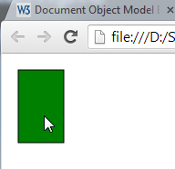
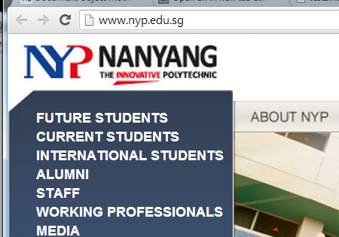
Adding Event Listeners to an SVG Object (Javascript) – Example 3
<!DOCTYPE html>
<html><head></head><body>
<svg width="500" height="100">
<rect id="rect1" x="10" y="10" width="50" height="80"
style="stroke:#000000; fill:green;"/>
</svg>
<script type="text/javascript">
var svgElement = document.getElementById("rect1");
svgElement.addEventListener("click", dosomething1, false);
function dosomething1(evt) {
window.open("http://www.nyp.edu.sg");
}
</script></body> </html>
On mouseclick
A rectangle is drawn in svg. Rectangle ID is = rect1
An event listener is added to listen to CLICK events
The following triggers the dosomething1 function, which causes the NYP website to open.
Notes:
A rectangle is drawn in svg. Rectangle ID is = rect1
An event listern is added to listen to CLICK events
The following triggers the dosomething1 function, which causes the NYP website to open.

Slide 35
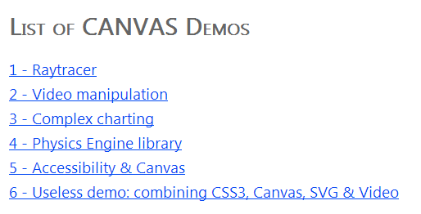
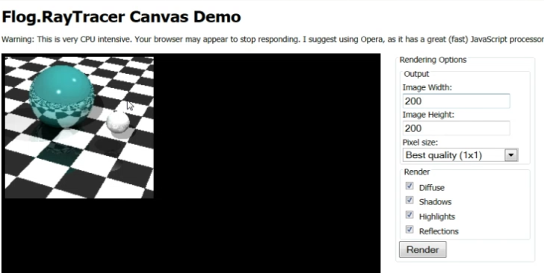
Canvas Scenarios & Demo
Notes:
Demo: KeyCanvasScenarios.aspx
1 RayTracer
2. Video Manipulation

Slide 36
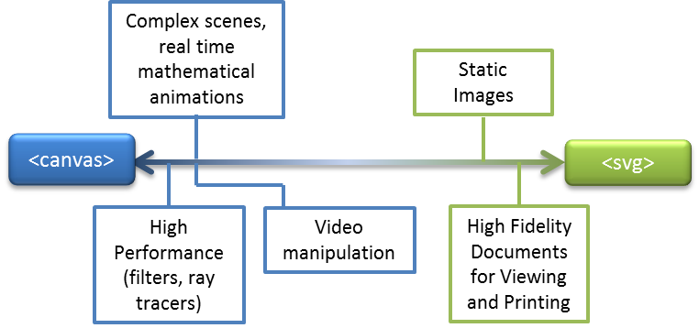
SVG vs Canvas
The easiest choices

Slide 37
Combination/Crossover Scenarios
More subtle differences
Charts and Graphs
  SVG better for interaction, XML data loading & for printing
  Canvas could be a faster rendering choice for some browsers
Two-Dimensional Games
  Canvas offers a more familiar experience to game developers (low level APIs, immediate mode as XNA, etc.)
  SVG does a lot of DOM operations and cost more memory
Notes:
Canvas more preferred for games.
Interactive websites – eg charts – SVG preferred.

Slide 38
Comparison of Canvas and SVG
The table below shows some important differences between Canvas and SVG:
Canvas | SVG
Resolution dependent No support for event handlers Poor text rendering capabilities You can save the resulting image as .png or .jpg Well suited for graphic-intensive games | Resolution independent Support for event handlers Best suited for applications with large rendering areas (Google Maps) Slow rendering if complex (anything that uses the DOM a lot will be slow) Not suited for game applications Good for assistive technology (Eg for blind, deaf)

Slide 39
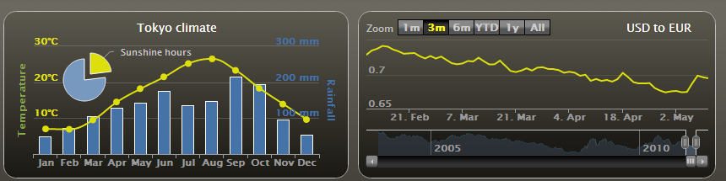
High Charts with SVG
Highcharts is a charting library written in pure HTML5/JavaScript, offering intuitive, interactive charts to your web site or web application. Highcharts currently supports line, spline, area, areaspline, column, bar, pie, scatter, angular gauges, arearange, areasplinerange, columnrange, bubble, box plot, error bars, funnel, waterfall and polar chart types.

Slide 40
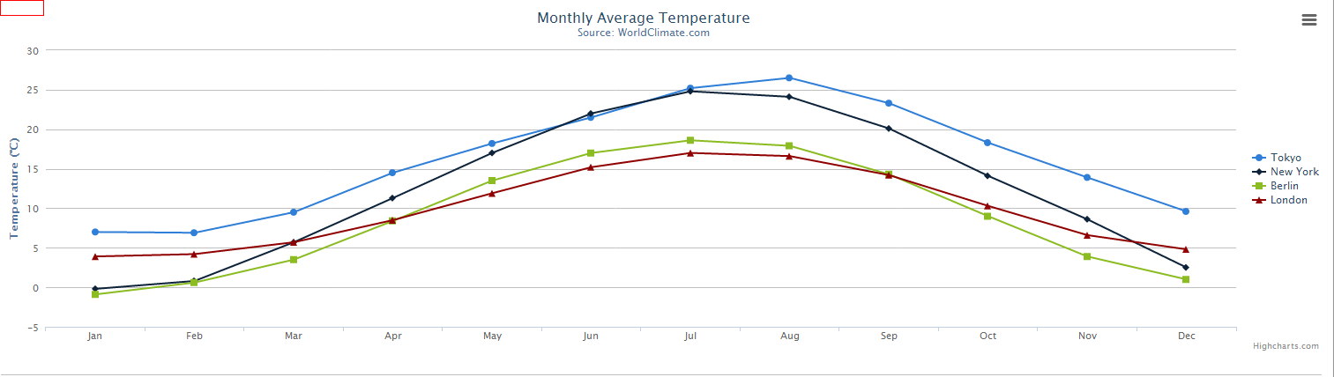
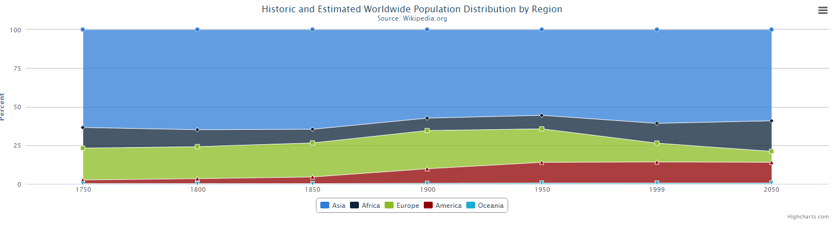
Chart Types
Chart Type | Example
Line
Area
Highcharts supports many chart types. Here are some examples.

Slide 41
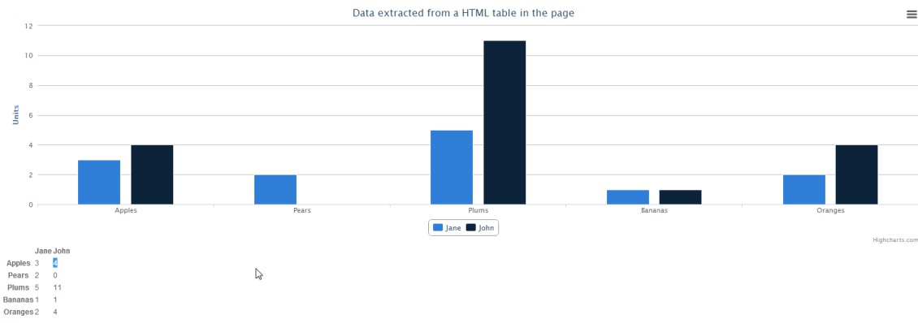
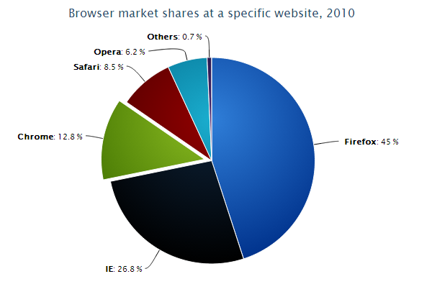
Chart Types
Chart Type | Example
Column
Pie

Slide 42
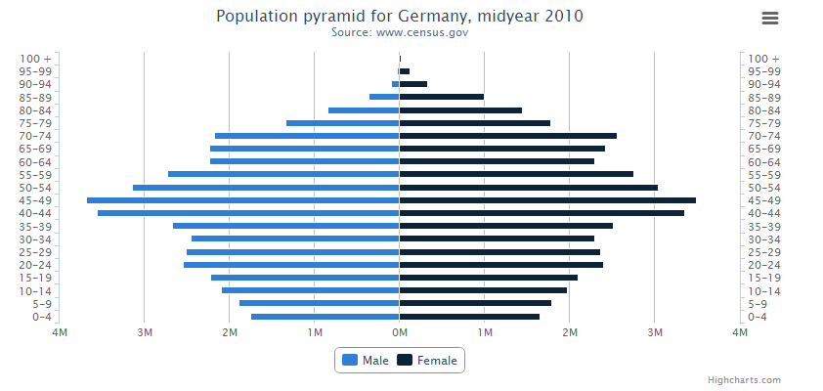
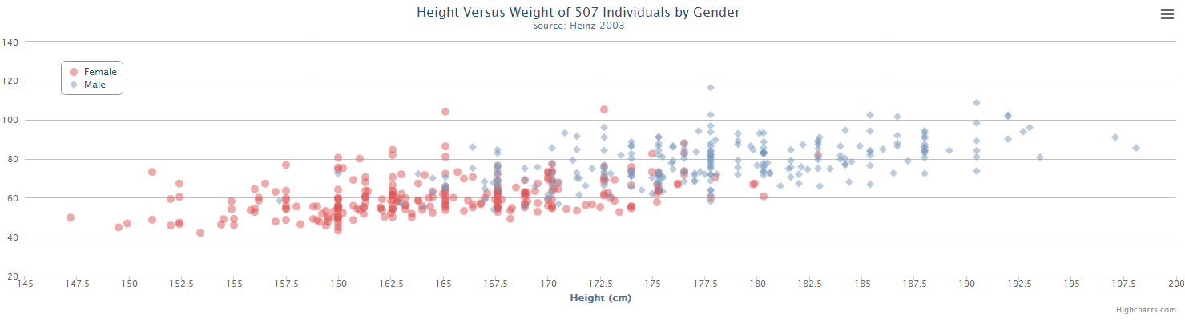
Chart Types
Chart Type | Example
Column with negative values
Scatter Plot

Slide 43
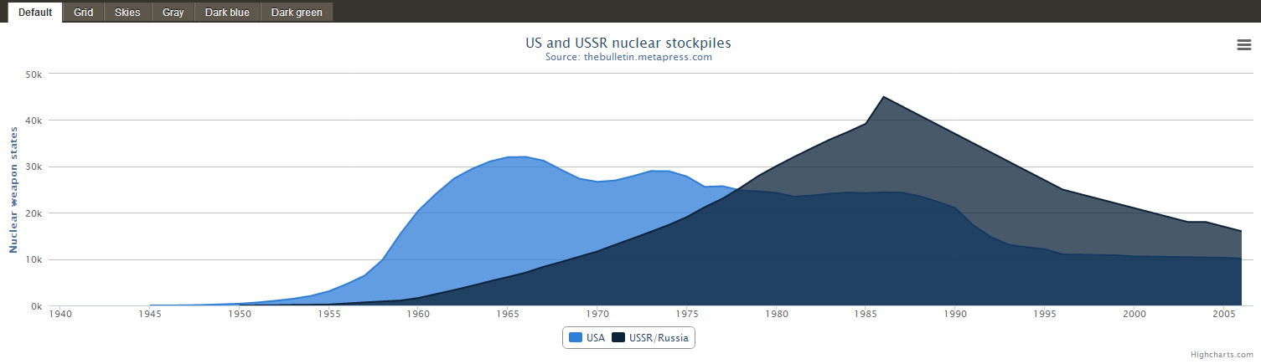
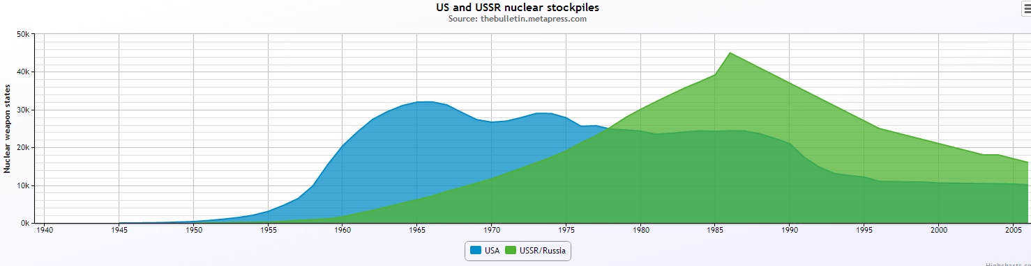
Chart Style
Chart Style | Example
Default
Grid Grid.js
Highcharts supports several predefined styles

Slide 44
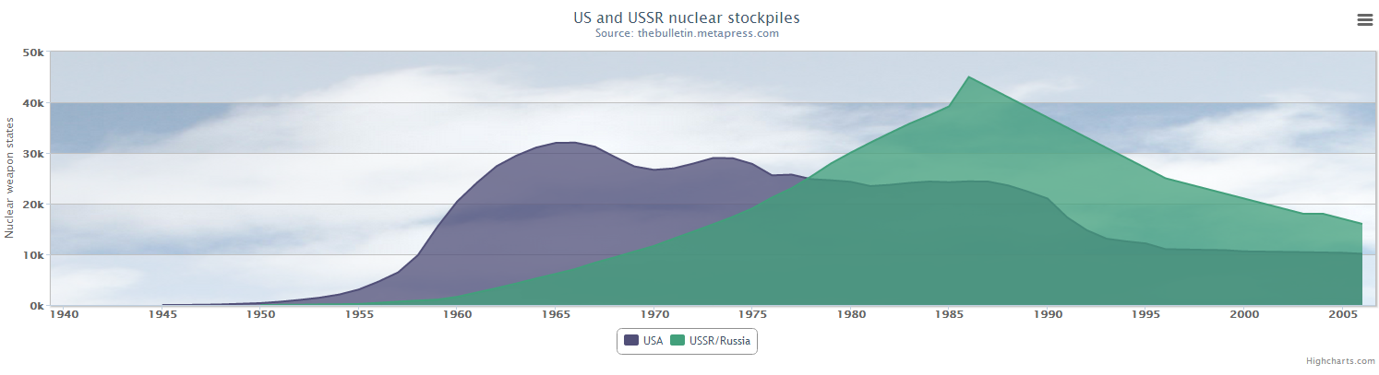
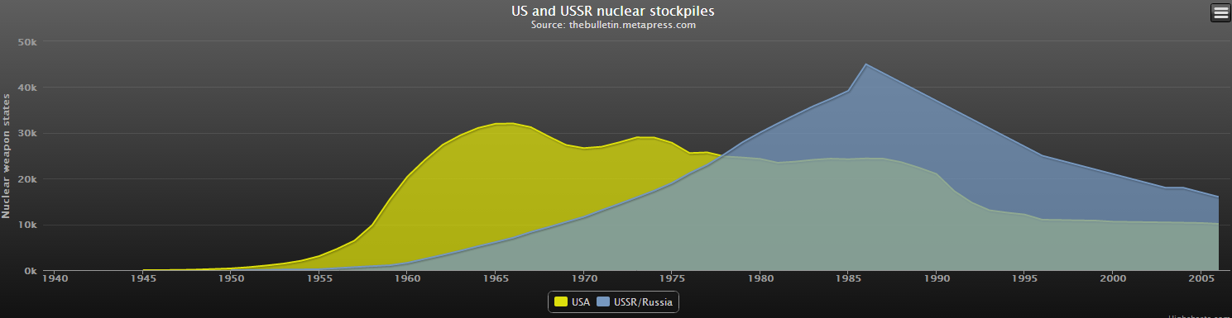
Chart Style
Chart Style | Example
Skies skies.js
Gray Gray.js
Notes:
Styles include also Dark Blue and Dark green
http://www.highcharts.com/demo/area-basic/gray

Slide 45
Chart Installation
Highcharts requires the following script in the head of the html document:
  <script src="https://code.highcharts.com/highcharts.js">
  </script>
For more info:
  http://www.highcharts.com/docs/getting-started/installation

Slide 46
High Charts with SVG
High Chart demo
http://www.highcharts.com/demo/
JSFiddle
http://jsfiddle.net/gh/get/jquery/1.9.1/highslide-software/highcharts.com/tree/master/samples/highcharts/demo/line-basic/
High charts API reference
http://api.highcharts.com/highcharts
  We will learn how to use this API in the practical lesson that follows.
Notes:
Show demo
Use JSFiddle to demonstrate how to change values
Show high charts API reference

Slide 47
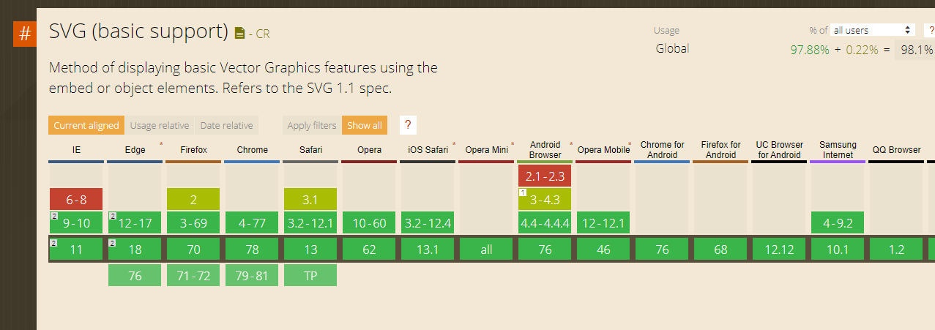
SVG Support
For other browsers support and versions : http://caniuse.com/svg
Notes:
Filter effects are supported / can be achieved by CSS3.
Most SVG features are supported by the latest versions of major browsers

